Slide 1
Project Title: Task Manager with Progress Tracker
CAPSTONE PROJECT
Presented By:
Student Name :-Vadlamudi Adarsa Naga Tulasi
College Name:- Seshadri Rao Gudlavalleru Engineering College
Department:- CSE (Artificial Intelligence and Machine Learning)

Slide 2
OUTLINE
Problem Statement
System Development Approach
Algorithm & Deployment
Result
Conclusion
References

Slide 3
Problem Statement :-
Many users find it hard to manage daily tasks and track progress.
This app allows users to add, edit, complete, and delete tasks while visualizing progress.
It improves personal productivity and time management.

Slide 4
System Approach
Frontend Stack:
HTML5 – Builds the structure of the app.
CSS3 – Adds style and makes it mobile-friendly.
JavaScript – Powers task actions and progress updates.
Local Storage – Saves tasks even after closing the browser.
Design Highlights:
Clean and user-friendly layout.
Mobile-responsive design.
Separate HTML, CSS, and JS files for easy maintenance.

Slide 5
Algorithm & Deployment :-
Task System Setup:-
Create tasks with fields like title, description, and status (To Do, In Progress, Done)
Optionally add due dates and priority levels
Use Local Storage to save tasks even after closing the browser
Frontend Design:-
Build layout using HTML5 and CSS3
Use Flexbox or Grid for arranging task cards and progress bar
Organize tasks visually by category for easy navigation
Interactive Features:-
Use JavaScript to add, edit, delete, and mark tasks as complete
Show real-time progress with a percentage or visual bar
Allow users to filter tasks by status or priority
Use modal popups for viewing or editing task details.

Slide 6
Algorithm & Deployment :-
Testing:-
Check for browser compatibility across Chrome, Firefox, Edge, etc.
Make sure the design works well on mobile devices
Deployment:-
Host the app using GitHub Pages or Netlify
Provides free, fast, and easy access from any device.

Slide 7
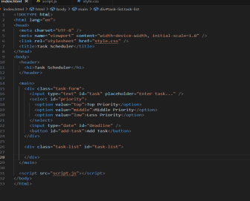
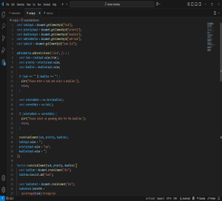
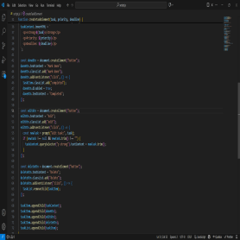
Result- code

Slide 8
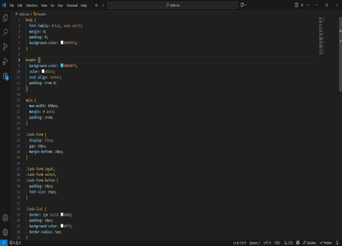
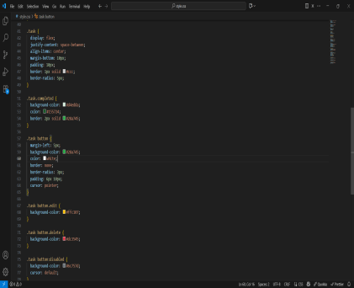
Result- code

Slide 9
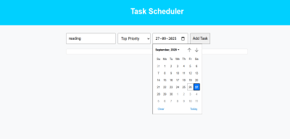
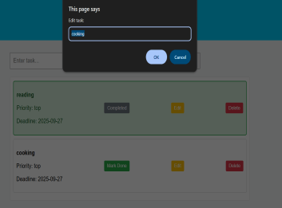
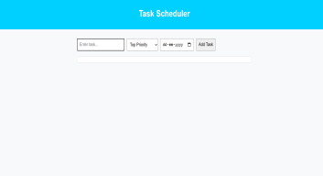
Result- output

Slide 10
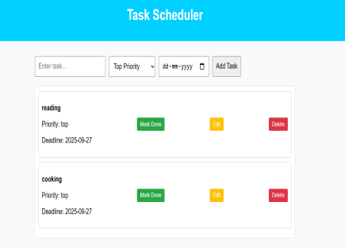
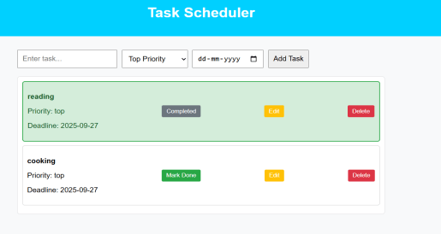
Result- output

Slide 11
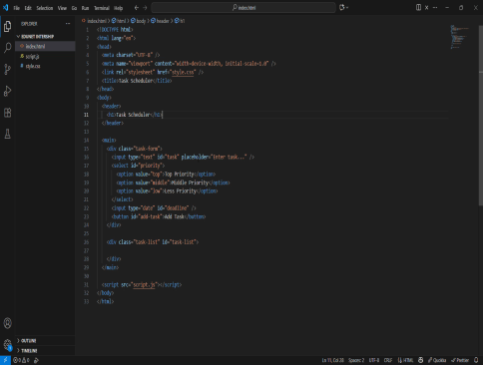
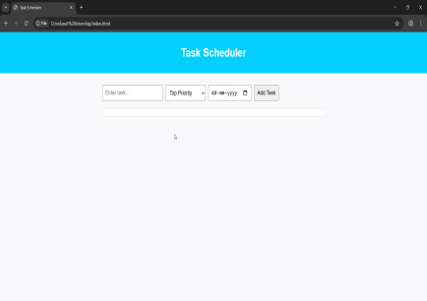
Result- output -videos

Slide 12
GITHUB AND DEPLOYMNET LINK
Github Link : https://github.com/Adarsa9119/FWD-Task-Manager-with-Progress-Tracker
Deployment link: https://adarsa9119.github.io/FWD-Task-Manager-with-Progress-Tracker/

Slide 13
Conclusion
The Task Manager with Progress Tracker helps users efficiently manage daily activities.
Provides features to add, edit, delete, and track tasks with real-time progress updates.
Enhances productivity, organization, and time management for individuals.
Lightweight and cost-effective solution, deployable on GitHub Pages or Netlify.
Future scope: Adding cloud sync, reminders, and team collaboration features.

Slide 14
References
List and cite relevant sources, research papers, and articles that were instrumental in developing the proposed solution.
https://www.geeksforgeeks.org

Slide 15
THANK YOU

